Slide 1

Maths at Moss Hall
Years 1 & 2

Slide 2
Which is the odd one out and why?
5 10 12

Slide 3
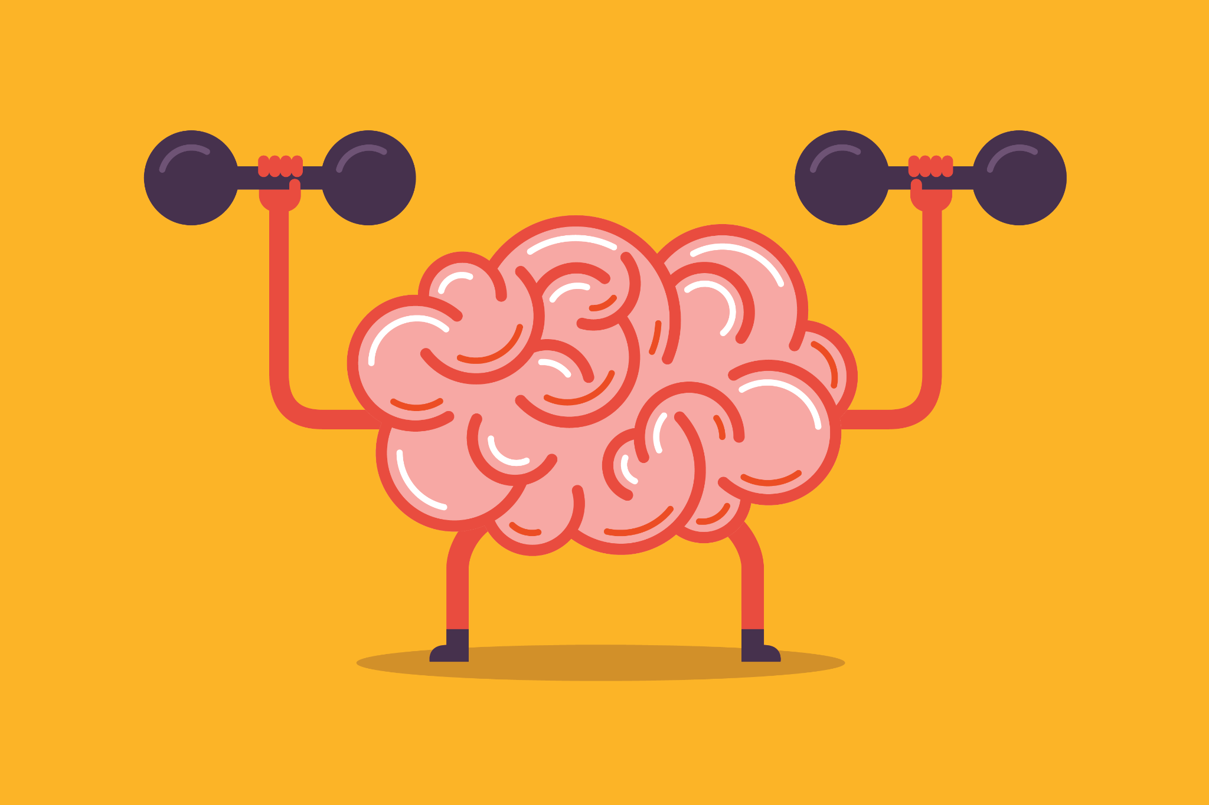
Fixed and Growth Mindset - Carol Dweck
We believe that everyone can get better at maths…when they put in the effort and work at it.
➔ Instead of praising children for being clever when they succeed at something, instead praise them for working hard. ➔ Children learn to associate achievement with effort (which is something they can influence themselves – by working hard!), not ‘cleverness’ (a trait perceived as absolute and that they cannot change).

Slide 4
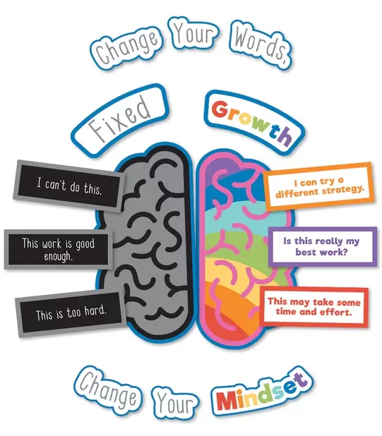
Fixed and Growth Mindset

Slide 5
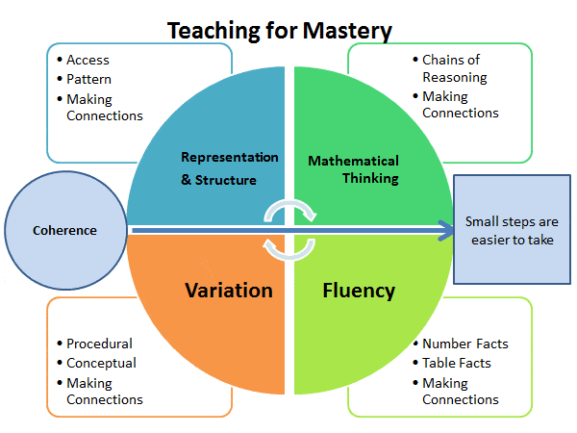
Mastery at Moss Hall
Maths - Moss Hall Schools Federation

Slide 6
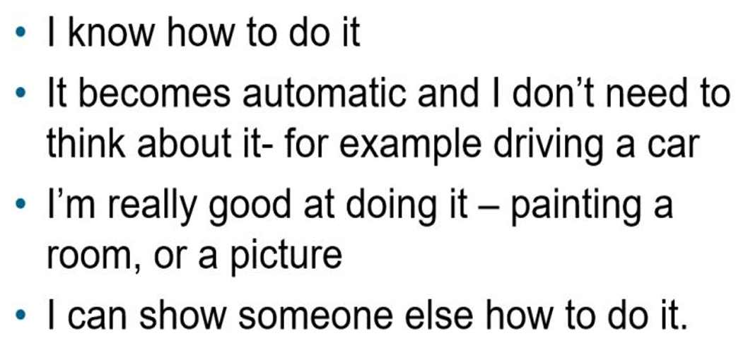
Mastery at Moss Hall

Slide 7
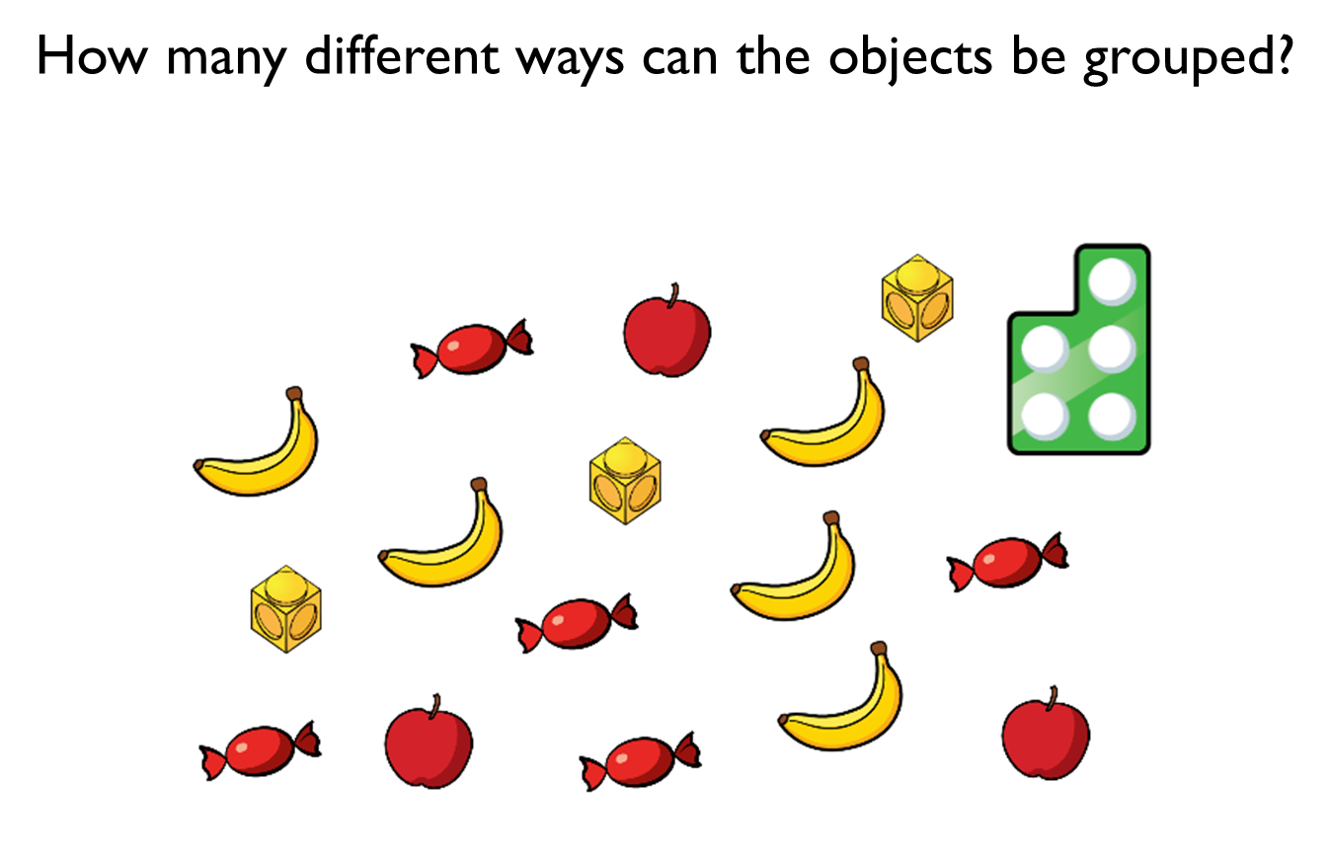
We Do
Questioning and talk

Slide 8

Our Curriculum
Year 1 - White Rose Maths
Year 2 - White Rose Maths
Advice and guidance for parents | White Rose Maths

Slide 9
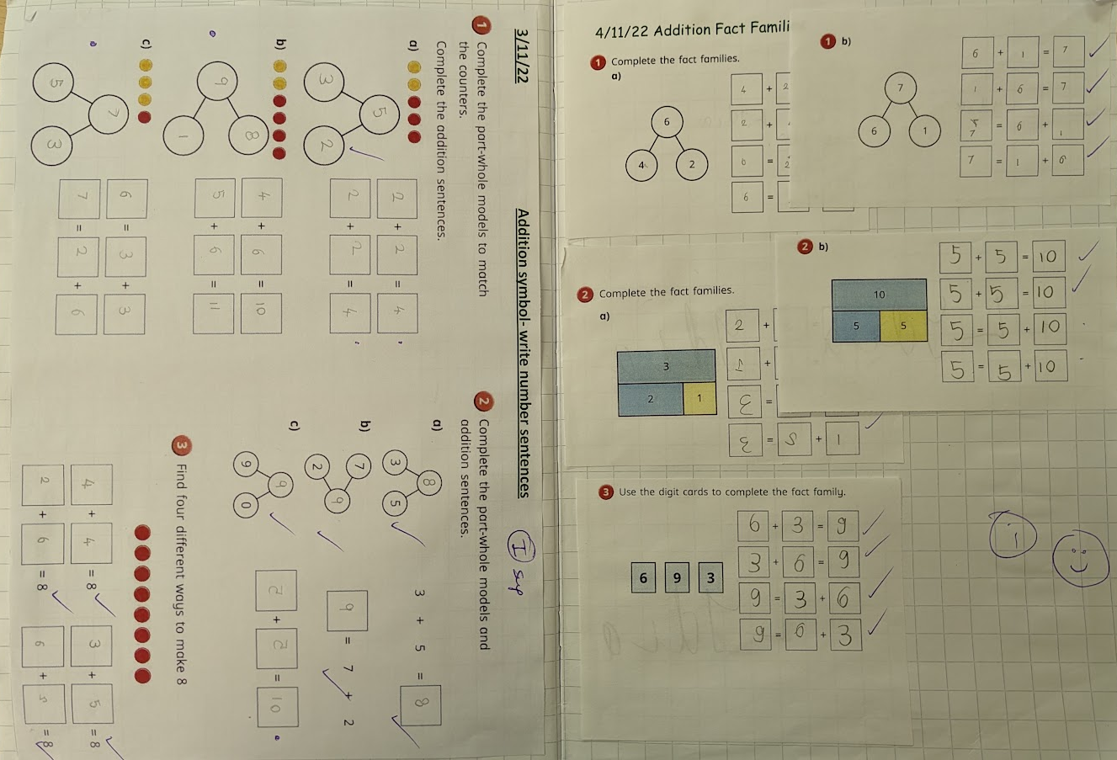
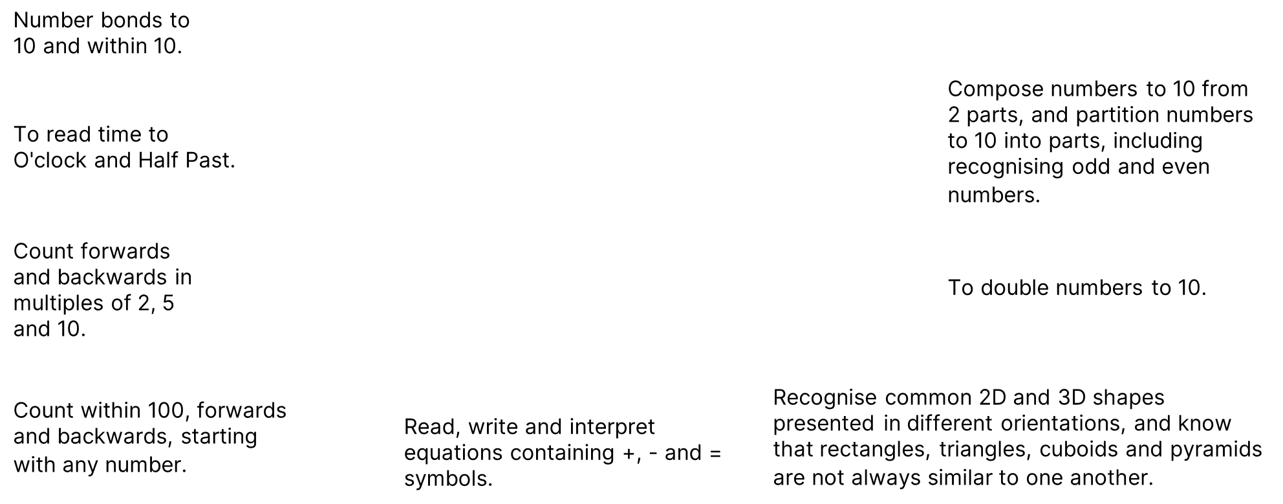
Year 1 Maths Books

Slide 10
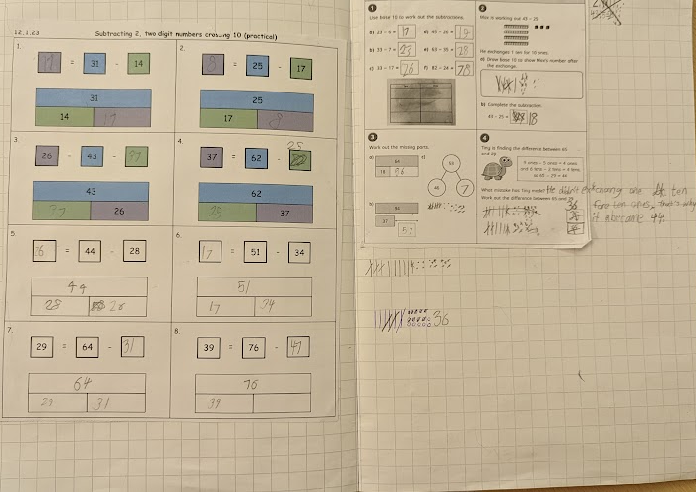
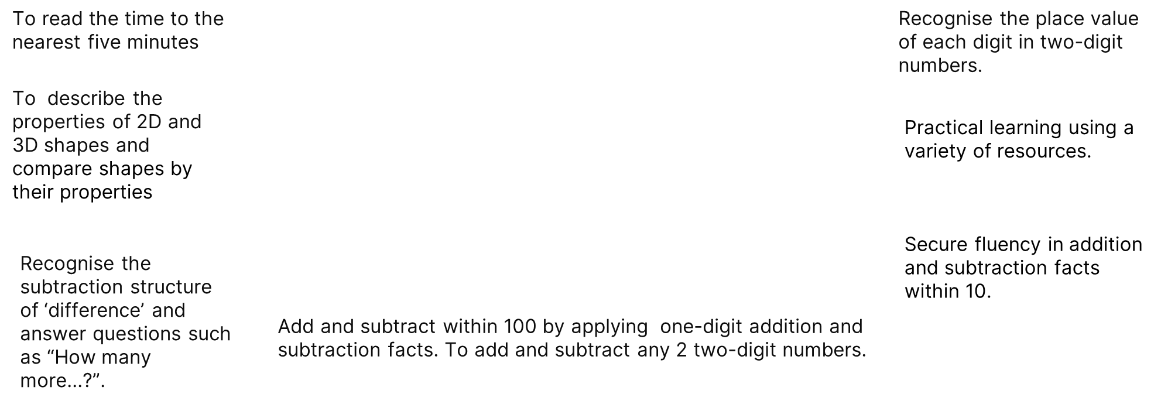
Year 2 Maths Books

Slide 11
Maths Concepts
Addition and subtraction calculation policy
Multiplication and division calculation policy

Slide 12
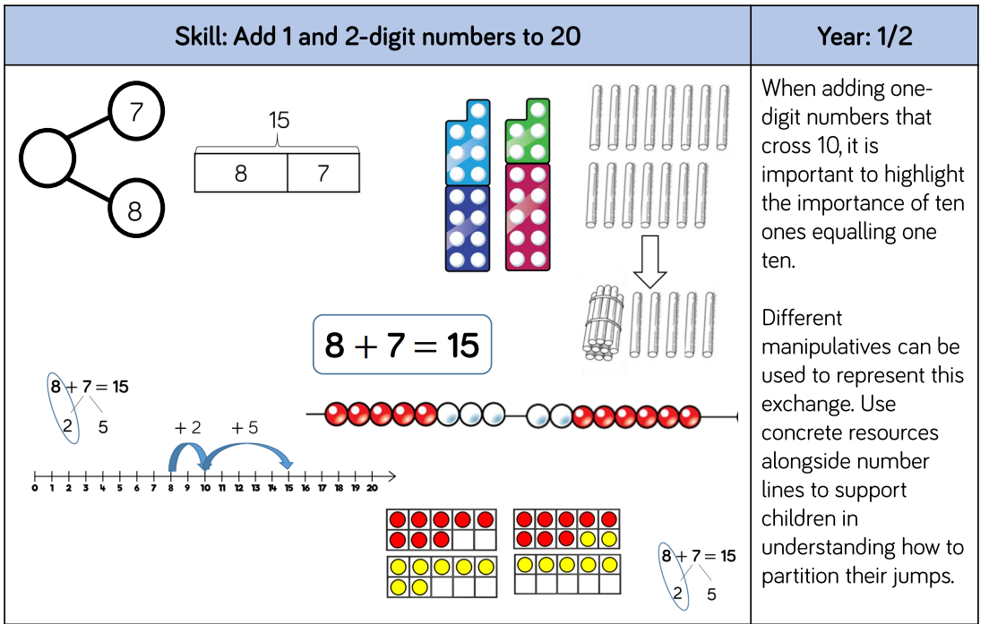
Addition and Subtraction

Slide 13
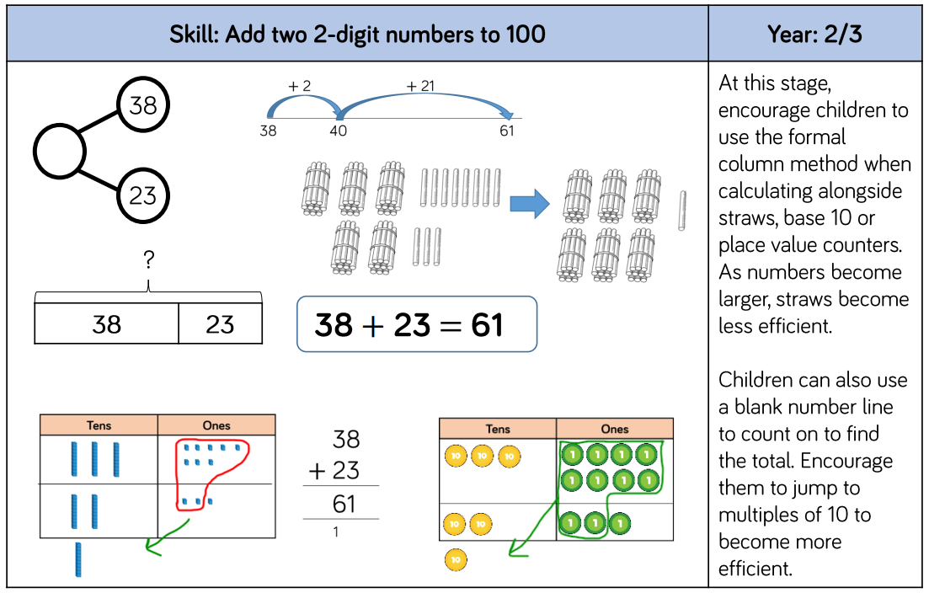
Addition and Subtraction

Slide 14
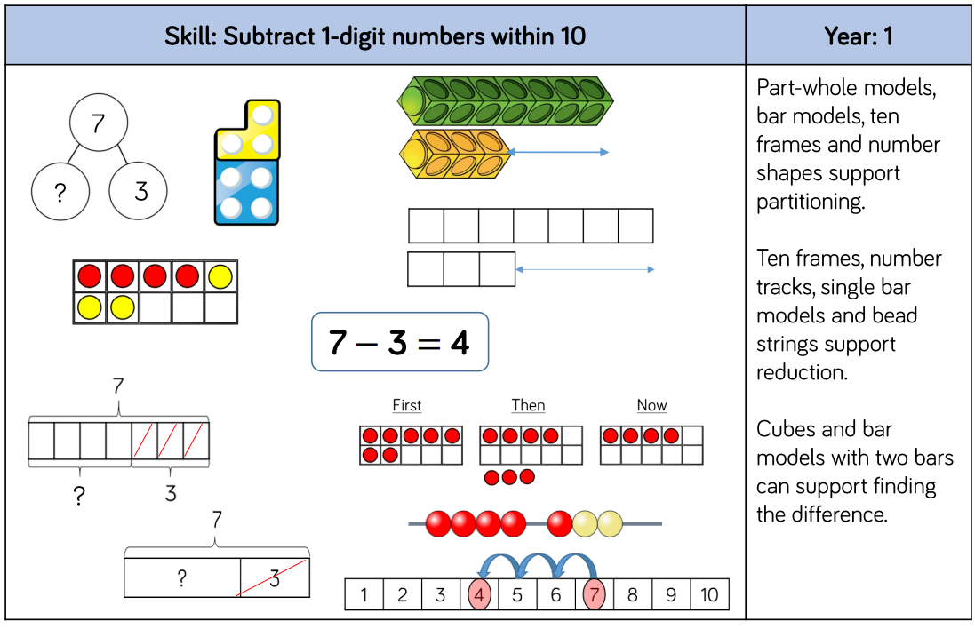
Addition and Subtraction

Slide 15
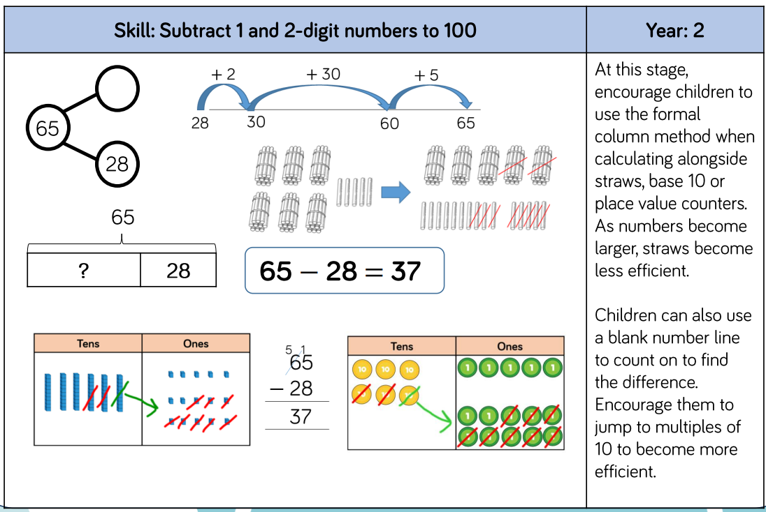
Addition and Subtraction

Slide 16
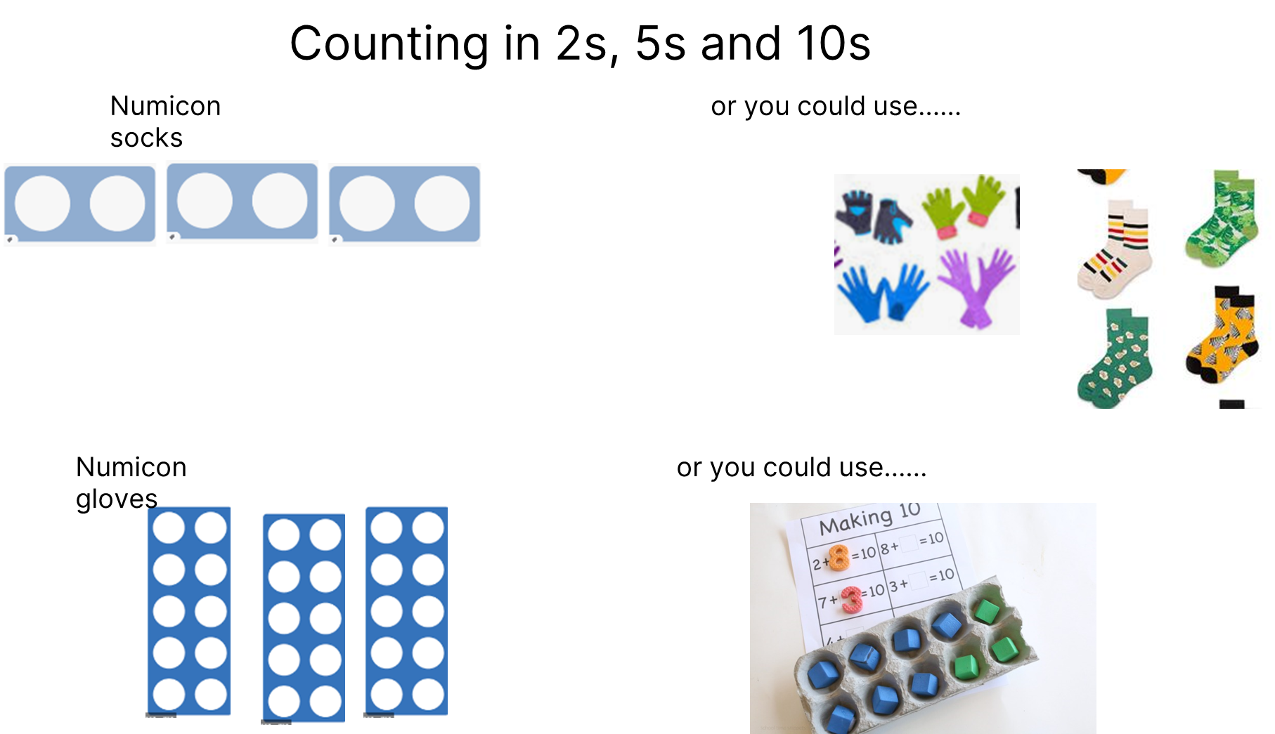
Times tables

Slide 17
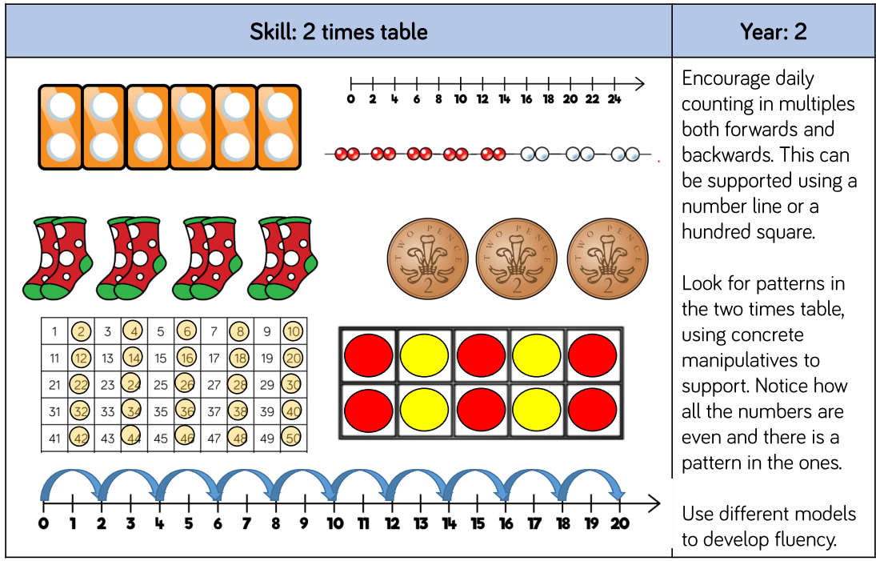
Times tables

Slide 18
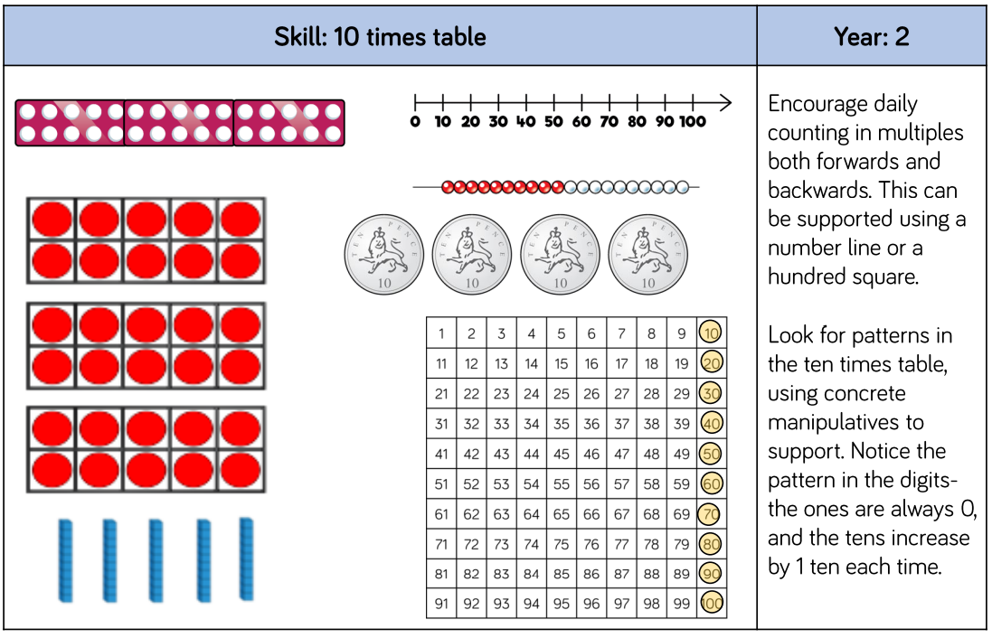
Times tables

Slide 19
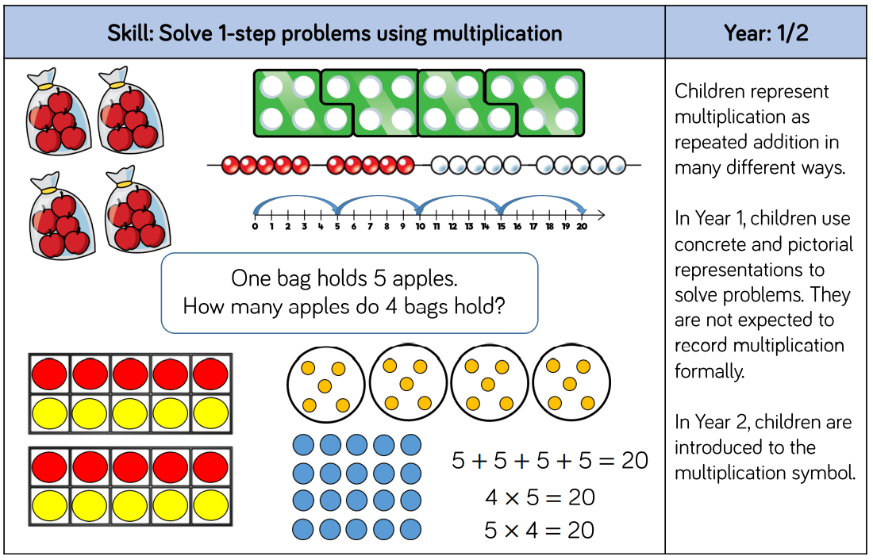
Multiplication

Slide 20
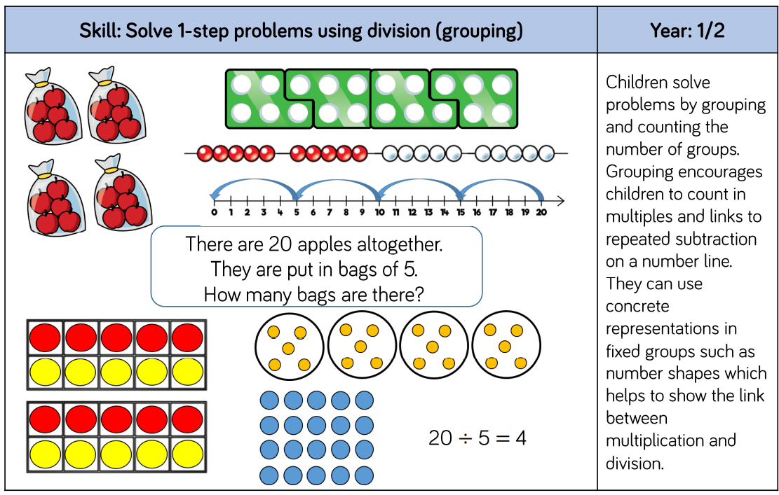
Division

Slide 21
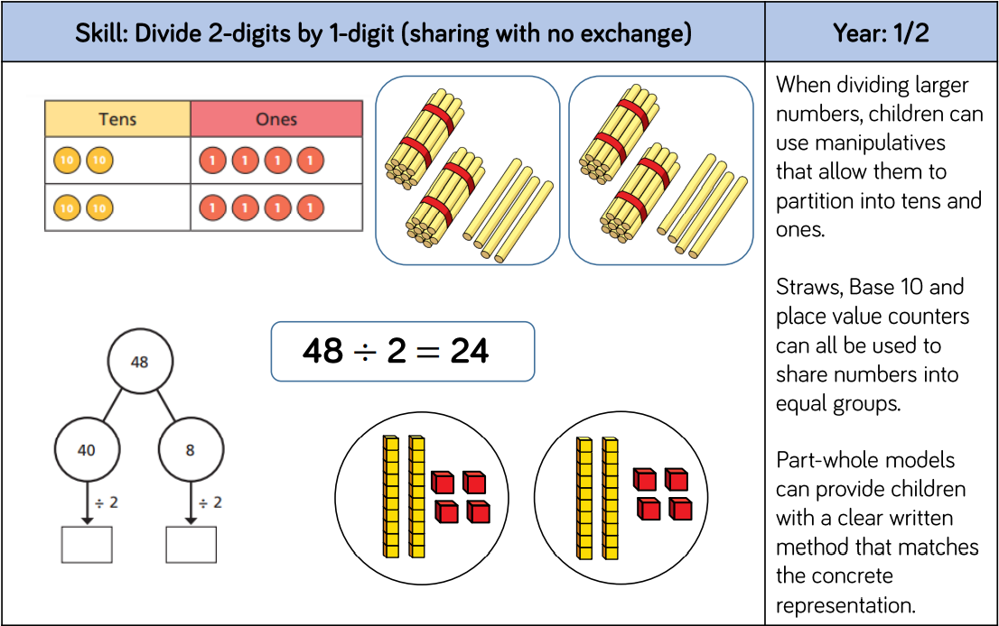
Division

Slide 22
How can you help your child with Maths at home?
*Take away their fear
*Let your child know you believe they can be successful in maths
*Encourage and support risk taking and celebrate perseverance.
*Encourage your children to solve problems with you
*Help them identify different methods or strategies to use in finding solutions and resist the temptation to provide the answer or method
*Provide opportunities for your child to explain and justify their thinking
*Seeing mistakes as an opportunity to learn and using them to discuss

Slide 23
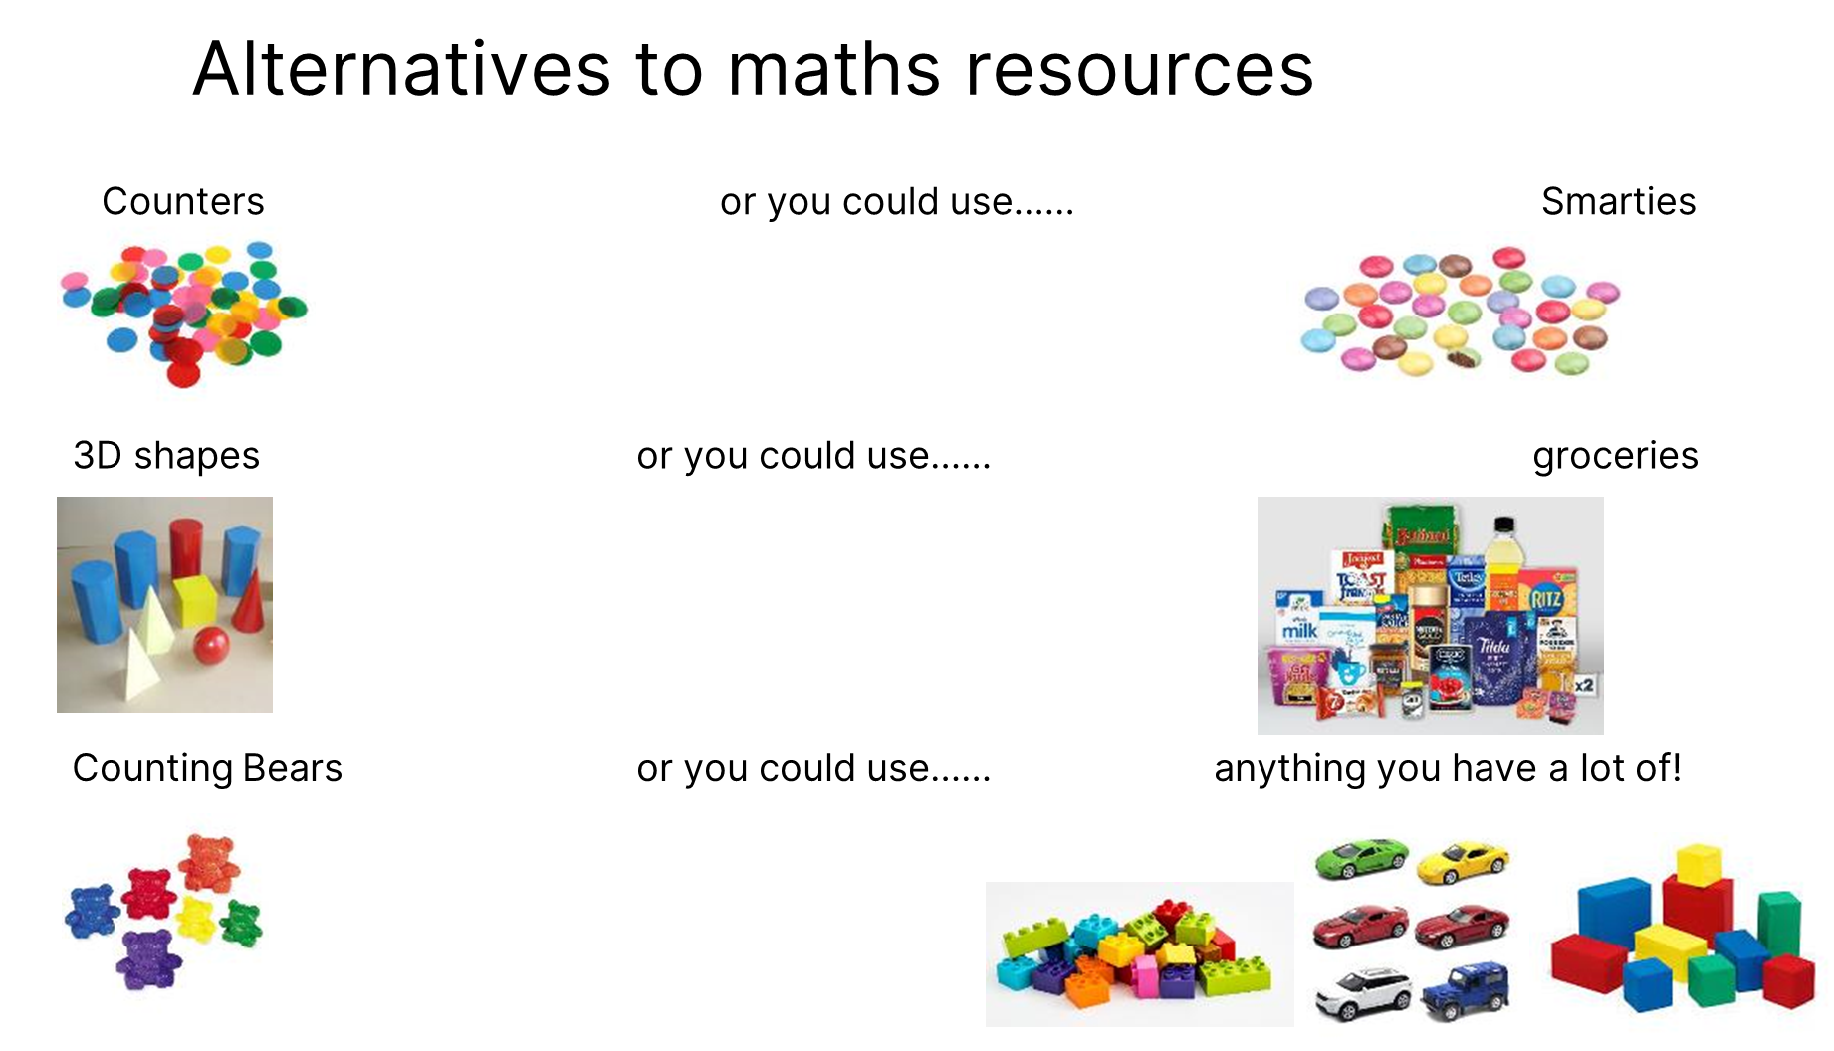
How can you help your child with Maths at home?

Slide 24
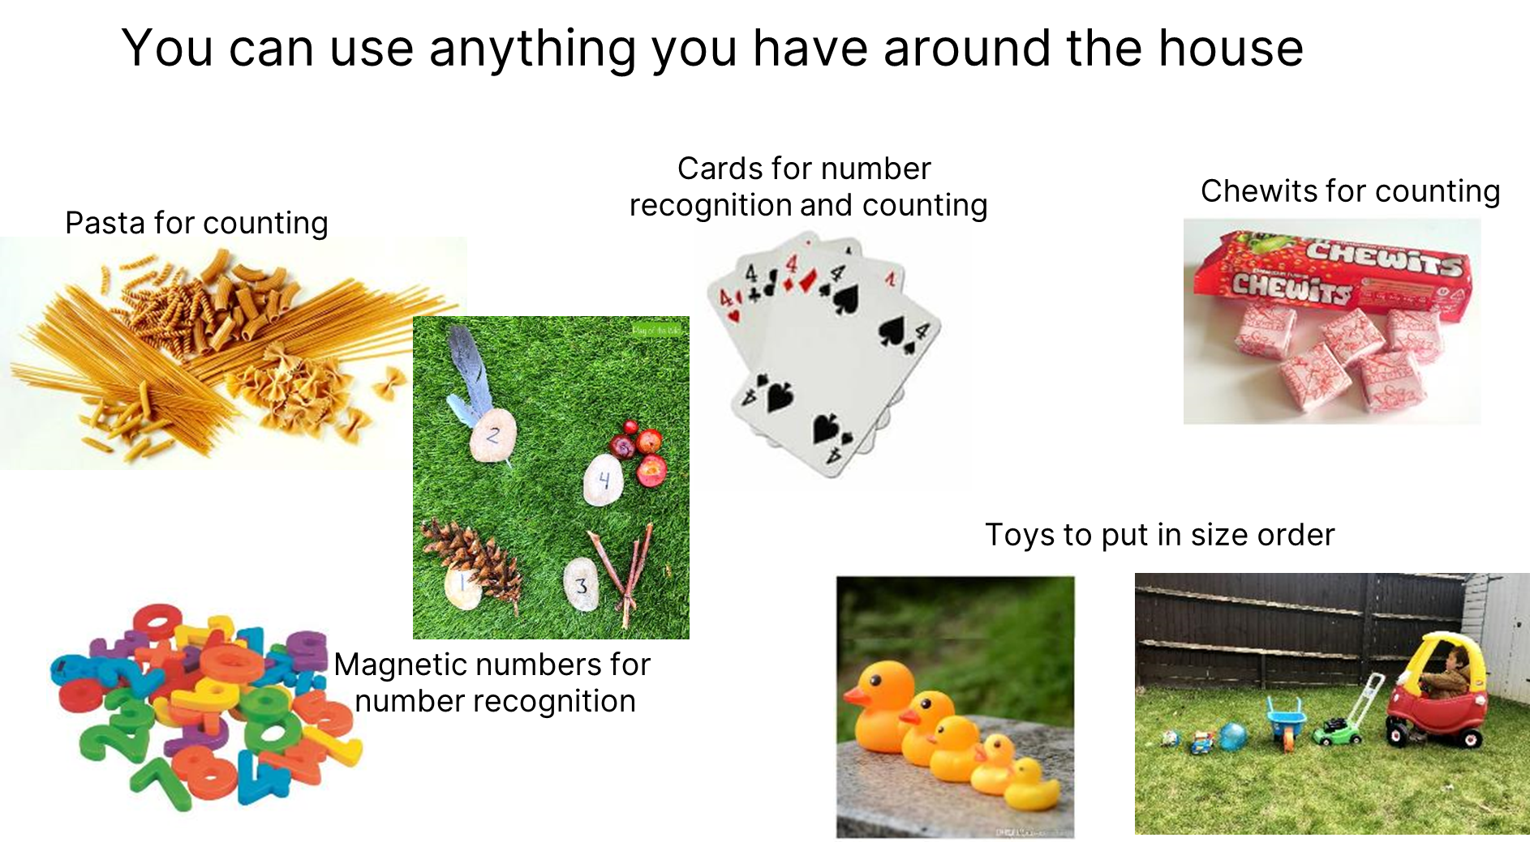

Slide 25
How can you help your child with Maths at home?
Connect mathematics to real life experiences. Emphasising the mathematics around us helps to make mathematics education relevant.
Managing money when shopping estimate how much it will be. How much change would you get from…?
Practise spotting and recognising numbers in the environment. Add/multiply/subtract/divide door numbers, numbers on car registration plates, road signs and at the shop.
Use food packaging to discuss 2D and 3D shapes. What are the properties of these shapes e.g. how many faces, sides, vertices? Flatten the packaging out to find the net of the 3D shape too.

Slide 26
How can you help your child with Maths at home?
Connect mathematics to real life experiences. Emphasising the mathematics around us helps to make mathematics education relevant.
Measuring up for new furniture? Want to make sure the Christmas tree will fit in your living room? These are really good opportunities to encourage your child to see the value of careful measuring skills in everyday life.
Practise telling the time with your child. Can they read both the digital and analogue clock? Can they readily convert between the two and use the 24 hour clock?
Board Games supply endless opportunities for Maths – Snakes and Ladders, Monopoly, Bingo, Connect Four, Battle Ships etc

