Slide 1


Emotion Coaching
Parent & Carer Workshop
Moss Hall Infant & Junior Schools

Slide 2

Your link to Barnet’s Educational Psychology Team
Previously worked in Hertfordshire and Southwark Educational Psychology Teams
Emotional wellbeing group interventions in primary schools
Educational Research
Masters Thesis focused on factors linked to literacy and prosocial behaviour in primary school children.

Slide 3


Introduction
- Participate (as much as you feel comfortable)
- Enjoy
- Confidentiality
- Listen to each other
- Empathise
Notes:
Respect- if others bring sensitive situation to be respectful and not share outside of the room.

Slide 4

Aims of the session
To consider children’s emotional development and needs
To understand and learn the steps of using an emotion coaching approach
To promote a consistent approach to support children’s emotional development across home and school.
Notes:
Hopes for the session
Many Moss Hall Teachers use an EC approach

Slide 5
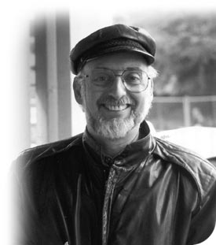
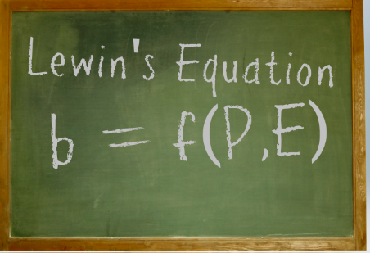
Emotion Coaching - Rationale
“Much of today’s popular advice ignores the world of emotions. Instead, it relies on child-rearing theories that address the children’s behaviour, but disregard the feelings that underlie that behaviour”
Gottman, 1997
“behavior is a function of the person in their environment.” (Lewin, 1936).
Notes:
Important to acknolwege feelings as they inform how we act .
Behaviour tells us important information about what children need.
Behaviour is a form of communication- Behaviour is a means of communication, and all behaviour has a functional element- it tells us about something the child needs. When we look at it this way we can address underlying need and redirect behaviour to more acceptable alternatives.

Slide 6
Emotion Coaching - Rationale
Notes:
We have to teach skills to recognise and manage our emotions just like any other skills.

Slide 7
What is Emotion Coaching?
Adults can adopt this evidence-based approach to pre-empt, or as a response to, challenging behaviour
Emotion Coaching enables children to manage their behaviour by helping them to understand the different emotions they experience, why they occur, and how to handle them
http://www.youtube.com/watch?v=bmsDTT3xgjo
Notes:
3-3:45
Caveat – secure in general with adults- so this will be teachers school staff also.

Slide 8

Video

Slide 9
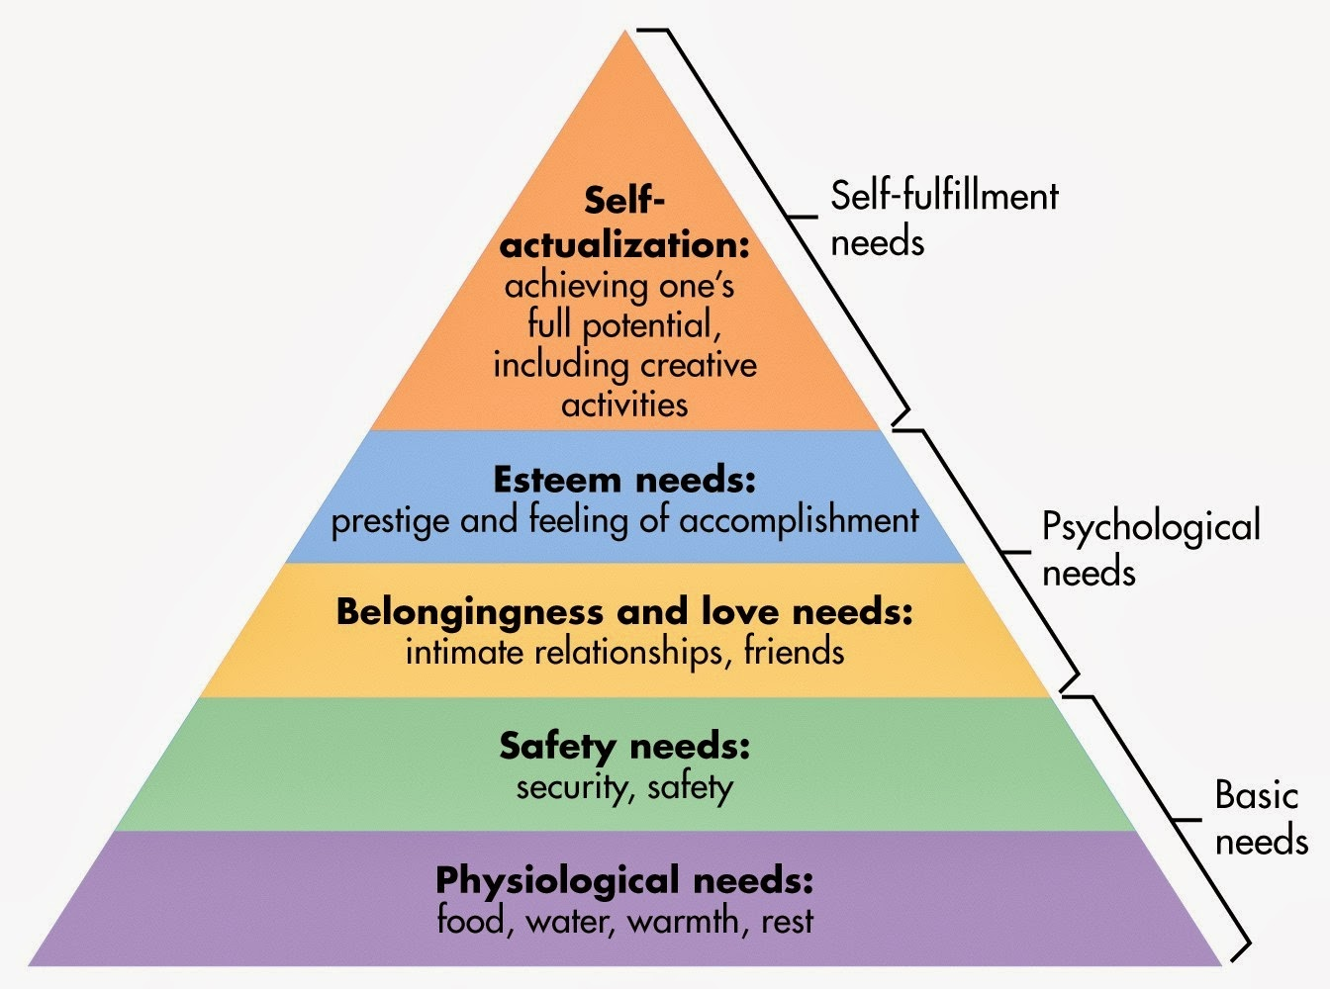
Notes:
Maslow’s hierarchy of needs

Slide 10

Potential Impact of Emotion Coaching Approach
Gottman’s research shows emotion coached children:
More resilient
Have better emotional regulation skills
Achieve better academically
Have more relationships with peers
Have fewer behavioural problems.
Notes:
Resilient they can recover for set back and challenges more easily.
Can manage emotions more by themselves
So supporting child’s emotions can help them to reach their potential- as when we are upset- the thinking and learning parts of our brain like attention and memory don’t function as well as they usually do.

Slide 11
When things go wrong
Children who weren’t emotion coached:
Have less of an ability to self-soothe
Less able to control their emotions and find tools to deal with their emotions
More likely to have trouble with school work
More likely to have problems with peers and behaviours
Have more stress-related hormones.
Notes:
Do not worry- this can seem negative, but these are skills that can be taught and developed over time.

Slide 12
Through Emotion Coaching Children Learn:
To control their impulses (self-soothe and self-regulate)
To motivate themselves
To read their own aand others’ emotions and social cues
To empathise
Resilience
That their feelings are not the problem, but that the resulting behaviour might be.
Notes:
They know more emotions vocabulary and how adults are noticing feelings e.g. body signs and actions so they can recognise these in themselves first and then others. This can lead to empathy.
Feel confident that they have skills to handle situations that occur.
It normalise feelings- that they are ok. But that we need to help ourselves manage them and express them in healthy ways.
It tells them that it is safe to share their feelings and to engage in problem-solving
It shows that problems and conflicts can be resolved peacefully.

Slide 13
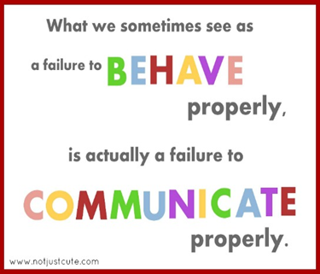
Importance of supporting emotional regulation
Behaviour is a means of communication,
and all behaviour has a functional element.
Children may find it difficult to express their unmet needs which can result in what can be perceived as ‘challenging behaviour’.
When children behave in a way that challenges us, we need to question why they're behaving in this way, consider the origins of the behaviour and what the message behind the behaviour might be.
This will help to understand the meaning behind the actions.

Slide 14
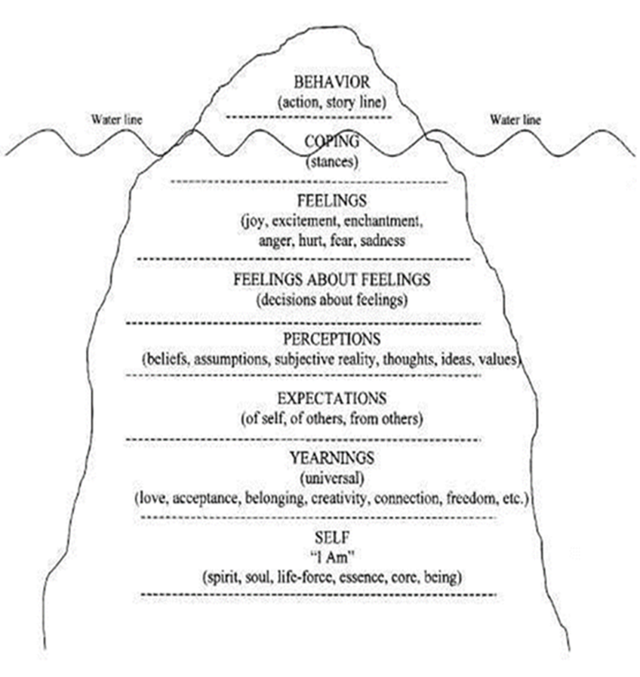
Why do children use less appropriate behaviours?
Notes:
We are wired to behave to meet our needs. Our needs, feelings and thoughts can influence our behaviours- younger children this is less conscious.
Needs ---- feelings ---- thoughts
We are driven to meet our needs in different areas of our lives
Striving to meet our needs leads us to experience feelings
These feeling cause us to behave in a way we think our needs will be met
When basic needs are challenged then we may be left feeling anxious and uncertain and react to these feelings
Our ability to react appropriately depends on our past experience and the resources we have to draw on – for children often they have less of a bank of experiences to draw upon.
The combination of factors can lead to behave in an unexpected or inappropriate way
We see behaviour but underneath there can be feelings, expectations, drive for acceptance, belonging, as well as beliefs about self.
Most children are trying to solve a problem rather than be one. Their solutions are often misguided because their concept of the problem is faulty or because their skills leave much to be desired or they have learned that a certain behaviour can meet their need.

Slide 15
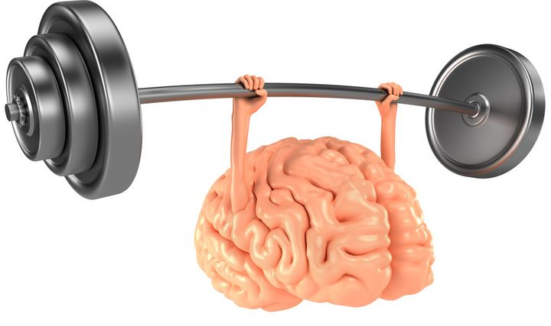
The Brain…
The more you use a pathway, the easier it becomes to use and it will become a chosen route to solve problems.
Notes:
Children have lots of different pathways in their brain and the more they use a pathway, the easier it becomes to use and it will become a chosen route to solve a problem.
The more evidence we have that we can solve problems gives confidence to try new things and new situations.

Slide 16
Internal Working Model
Memories of day to day
interactions
Expectations &
affective
experience
associated
with interactions
Accumulating
schemas
or event scripts
Guiding actions based upon
previous interactions

Slide 17

Why discipline may not work
Most discipline relies on the behaviour pattern
  impulse – thought – action
Systems of rewards or punishments rely on this principle
Such systems may not work for people who are unable to think before they act
  There is no thought to change
Notes:
Children are likely to act without thinking on impulse before they develop these skills through being shown and guided by parents.

Slide 18

What do we need as adults?
When you are feeling sad / angry / frustrated / upset / hurt / low, what helps you to feel better?
Notes:
What we notice = people want to feel understood and heard, listened to
We can articulate what about children
We can take action – what freedom do children have to overcome their feelings
Model and do with children
As continue listening think about how emotion coaching links to what works for you.

Slide 19

Building a Power Base
“Proposing solutions before empathising is like trying to build the frame of a house before you lay a firm foundation” (Gottman)
Emotional first aid is needed first.
CONNECTION BEFORE CORRECTION
RAPPORT BEFORE REASON
Notes:
Emotion coaching builds a power base that is an emotional bond – this creates a safe haven, a place of trust, a place of respect, a place of acceptance, a sense of self etc.
This in turn leads to children and young people giving back respect, acceptance of boundaries etc.

Slide 20

Our early experiences about emotions…
In our families
Experiences at school
What we learn from social media
…..impact what we believe about emotions and how we express them later in life.
Activity for your own reflection:
Identify some of the positive/negative messages you received from your parent/carers, siblings, extended family, friends, carers and others about emotions.
- How might these experiences affect responses to children’s emotions?
Notes:
Bear in mind through this.
My own example – don’t really remember ever being told not to cry or get upset – parents very empathic. I think this has resulted in me being more sensitive to my own and others emotions. I also empathise with others but then in turn find it more difficult when others are less empathic to children.

Slide 21

Emotion Coaching
Children need a high level of guidance and effort, and a high level of empathy. If an emotion coaching style is adopted 40% of the time, this is considered ‘good enough’!
This takes time to become proficient at – so take it one step at a time. E.g. start to use it at positive times, for small times of dysregulation.
The following response styles do not teach children to self-regulate and in turn can generate more difficult feelings:

Slide 22

Disapproving style
Disapproves of negative emotions – viewed as
a sign of weakness
Lacks empathy, noticeably critical and intolerant
Tries to get rid of negative emotions via telling child off or punishment
Focuses on the behaviour rather than the emotions behind the behaviour
More likely to view displays of negative emotions as a form of manipulation, lack of obedience, sign of bad character
Sometimes we do this as we feel a need to control and regain power and/or to ‘toughen up’ a child
Also known as authoritarian.
Notes:
Big children don’t cry

Slide 23
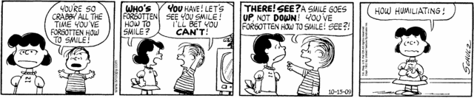

Slide 24
Dismissing style
Uncomfortable with negative emotions
Focuses on getting rid of the emotion with logic or distraction rather than understanding the feelings
Thinks paying attention to such emotions will make them worse, prolong them
Tries to stop negative emotions by reducing / minimising / making light of their importance/significance
e.g. it’s no big deal, don’t worry about it, that’s life, you’ll be fine
Notes:
Despite good intentions (wants to make child feel better) but is often where adults are uncomfortable with negative emotions
Often motivated by need to rescue and make things better, fix the problem e.g. have a biscuit, I’ll buy a new one, you need to do this

Slide 25

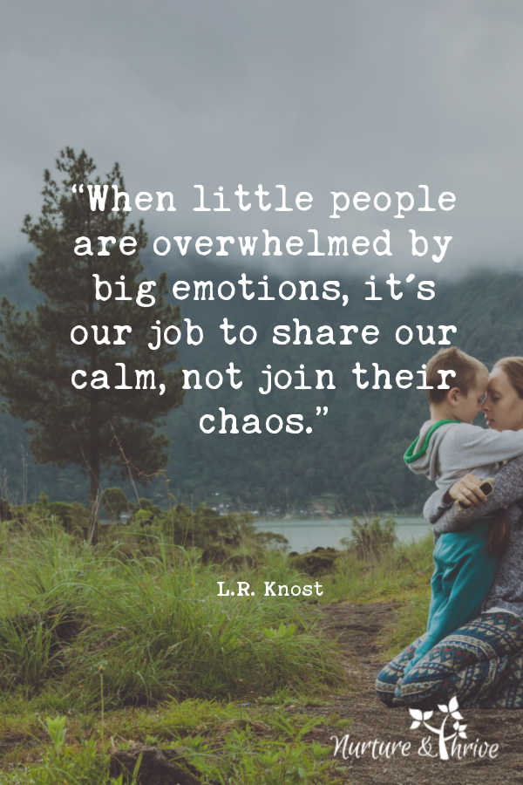
Laissez-Faire
Adult is overwhelmed by the emotions driving the child.
The adult feels helpless, afraid or distressed.
Despite the empathy of the adult there is no guidance on how to manage.
The behaviour can then escalate.
Notes:
Maintain warm detachment
Not take behaviours personally
Think bk to earlier exercise
Matter of fact responses
Best to call for help if need
Not weakness – shows awareness of own feelings and needs - culture of helping each other out – change of adult can be supportive to children

Slide 26
ACTIVITY: SCENARIOS
Voting time: Are each of the following scenarios an example of an Emotion Coaching approach or a dismissive approach?

Slide 27
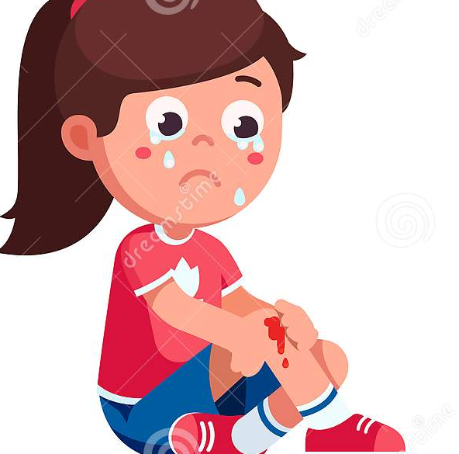
Mariana falls down whilst going to the park and is upset and holding her knee.
Adult: “Silly girl, I told you not to run, come on now, stand up. I don’t want to see tears, you are going to make us all late.”
Notes:
Dismiss/disapproving

Slide 28
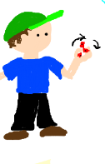
Ali has found a fidget spinner on the way to school and he is excited about this and shows it to a teaching assistant. Adult: I’m sorry but you cannot keep it, it doesn’t belong to you. Let’s put it back where you found it.”

Slide 29
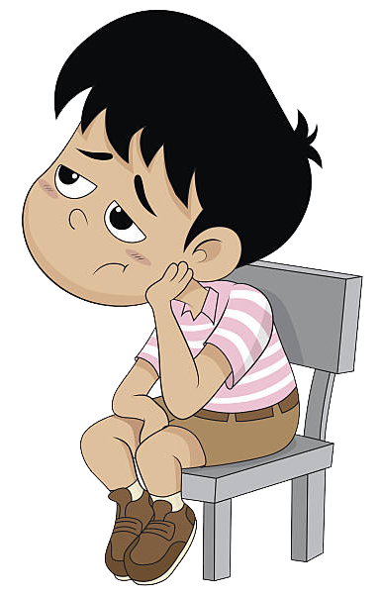

The teacher has spent the first 5 minutes of the class explaining the activity and has now asked the group working to have a go. She notices that Jared hasn’t started and is starting to bother other pupils. The teacher prompts Jared to have a try.
Jared: “I’m not doing it.” Teacher: “Is there something about the task that is tricky for you? Let’s see if we can figure it out.” Jared: “Go away!” Teacher: “I can see you’re annoyed and fed up Jared. Let me make sure everyone else is started and then you and I can figure out what is the matter and see what we can do about it.”
Notes:
Emotion Coaching

Slide 30
Activity: Reflect on your style

Slide 31
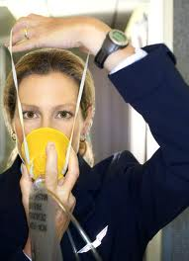

How do we do Emotion Coaching?
FIRST
Having emotional awareness of own emotions
(meta-emotion philosophy)
“Put on the oxygen mask first
before putting it on the child”
Notes:
I used to work with a child where I would get quite anxious- once I told myself to breathe and that I can handle this, this really helped me in the future.
Put my own oxygen mask on first.
Recognising the power and purpose
of emotions
Empathising
Active listening / Rapport building
Scaffolding / Problem solving together
Role-modelling

Slide 32
5 Steps of Emotion Coaching
Be aware of child’s responses and emotions.
Recognise emotional times as opportunities for intimacy and teaching - connection before correction.
Recognise feelings
Listen empathetically
Validate the child’s the feelings.
Help child to verbally label emotions – helps sooth the nervous system and recovery rate.
Set limits while helping child to problem-solve using active listening and scaffolding.
http://www.youtube.com/watch?v=bmsDTT3xgjo
Notes:
32
4:45

Slide 33
1. Empathise
2. Validate
3. Label
Recognise all emotions are natural, normal and not a matter of choice.
Look for physical and verbal signs of the emotion being felt
Use words to reflect back the child’s emotion and help child/young person to label emotion.
Affirm and empathise, allowing the child to calm down through co-regulation.
Provide a narrative/translation for the emotional experience (creating cognitive links)
Avoid asking why they are feeling a certain why as they will often have no idea/not have the words to describe the reason
Notes:
Affirm- gives a release
As adults, we can sometimes ‘chose’ how we feel but this actually more about how we can manage our emotions- this is a skill.
Co-regulation- where a child requires an adult to help them to regulate or calm down.
33

Slide 34
Empathise, validate and label
Key phrases:
I see/I notice…
I hear…
Are you feeling…?
What else are you feeling?
I imagine that feels…
Tell me about that.
Are you saying….?
It sounds to me like you are feeling…Is that right?
How does that make you feel?
Notes:
34

Slide 35
W.I.N.
I Wonder…..
I Imagine…..
I Notice…..
‘I wonder if you feel frustrated by this ….’
‘I imagine that would make anyone feel upset …’
‘I noticed you looked happy about that….’

Slide 36
Examples (imagine it was you…)
Oh dear. It seems like you’re sad that Mo stuck his tongue out at you. That must hurt your feelings when someone pulls that face at you. It’s not a kind face. It’s OK to feel sad about that.
Oh dear. That’s not nice when someone breaks your Lego. That must be really disappointing when you’ve worked hard at something then someone else breaks it. It’s OK to feel cross about that. I would too.
Mmm. I wonder if you’re worried about getting it wrong. It’s normal to feel a bit anxious when you’re learning something new. Learning new things can feel hard sometimes.
‘I can see that you get angry when that happens. I would feel angry if that happened to me. It’s normal to feel like that’
Notes:
Adult examples

Slide 37

4. Setting Limits (if needed)
First, connect with the child. E.g. eye contact, arms open, sympathetic body language. This will engage the child’s social and emotional brain. Then the teaching and learning can happen.
State the boundary limits of acceptable behaviour
Identify the goal the child was trying to reach with behaviour
Make it clear certain behaviours cannot be accepted
Try not to shame the child’s behaviour but explain the reason it is not ok e.g. not safe.
Notes:
Label the emotion, empathised, set limit.
If needed as some children keep emotions to themselves (withdrawn/quiet). They still feel these emotions and we want to help children to manage and resolve their emotions rather than keeping them inside. If we dismiss or disapprove the feelings, the children learn to hide them (this can also be because of
I can see that you hit X because you were frustrated. It’s ok to feel frustrated, but it’s not ok to hit.

Slide 38
Examples
It’s really important in our family that we have kind hands with each other, and with our things. It’s not OK to hit people, or to break or throw things when we are sad.
‘We can’t behave like that even though you are feeling annoyed because it is not safe’
‘You didn’t put the ball away as we agreed. You’re probably angry that you can’t play with Billy now because you have to stop now’
I.e. It’s ok to feel…but it is not ok to…

Slide 39
5. Problem solving with the child
When the child is calm and in a relaxed, rational state:
  Explore the feelings that are behind the behaviour/problem/incident. Remember that all feelings are acceptable. We manage our feelings by making choices about how we respond.
  Scaffold alternative ideas and actions that could lead to more appropriate and productive outcomes. Trust the child to come up with ideas. Don’t jump in with solutions.
  Empower the child to believe s/he can overcome difficulties and manage their own feelings/behaviour
  If your child comes up with an unworkable solution, it is ok to go forward with it as long as it is harmless
Notes:
Sometimes this needs to take place later.
There is no point trying to reason when a child is upset as the thinking and learning part of our brain is not working properly.
Once they are safe- allow them to calm down and limit language at this stage.

Slide 40
Problem solving with the child
Key phrases:
What can you do to solve this problem?
What would happen if…?
Let’s look at some different choices.

Slide 41
Examples
If someone pulls a mean face to you/ breaks your Lego in the future, what could you do?
If you’re stuck with your work, or you don’t feel like writing, what could you do?
That’s a sensible idea. That way, you can share how you feel and everyone will be safe. And you won’t get into trouble! It’s OK for an adult to help us when we feel sad/ when we get stuck.
‘This is not a safe place to be angry. Let’s go to a safe place and then we can talk’
‘Next time you’re feeling like this, what could you do? How do you think you will react next time or if this happens again’
Notes:
‘You need to either….or…. which do you want to do?’

Slide 42
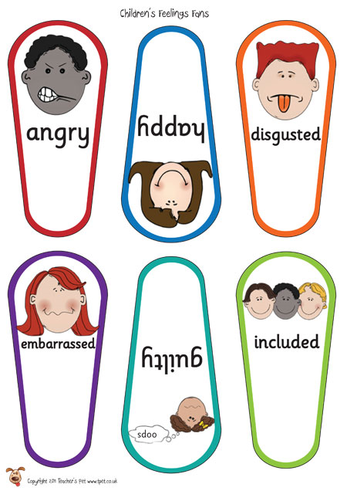

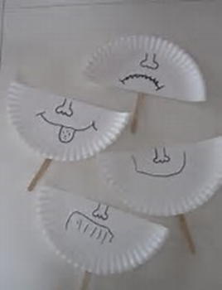
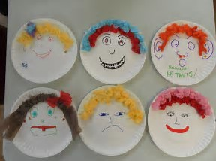
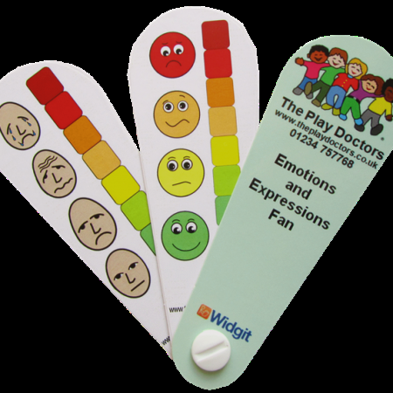

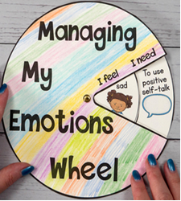
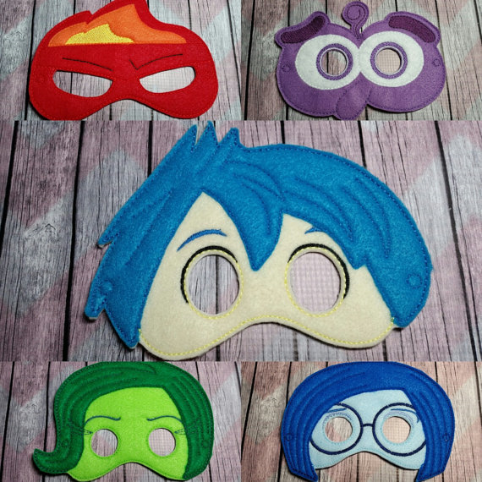
Resources
Notes:
Key for children who are not verbal
What else might you want to use?
Still model the same structure
Give ways to communicate feelings and solve problems- pictures of things they can do to calm down e.g. quiet space, movement.

Slide 43

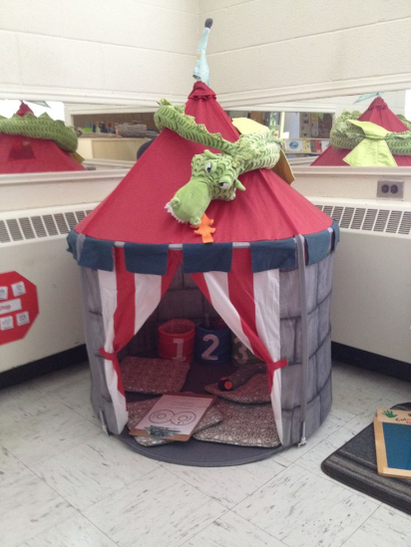

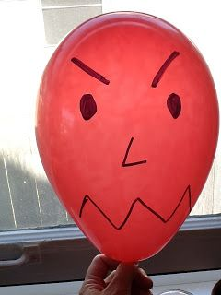
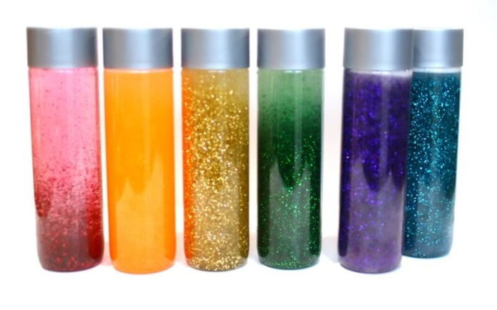

Calming activities
Vary with the child
Could include:
colouring
sensory play
music
dance
time out area (tent, book corner)
breathing techniques
stress ball

Slide 44
Scenario
One of your children makes a hurtful comment to their sibling while playing.
“I wanted to play with that truck but he got it first. I saw it first, but he got it. It’s not fair! I want a turn!”
What would you say next?

Slide 45
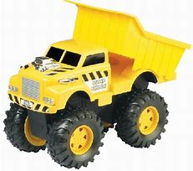
Scenario
Parent to child: “That hurt Timmy’s feelings! We don’t use hurting words. You
sound pretty upset.”
Child: “I wanted to play with that truck but he got it first.”
Parent: “You really want a turn with that truck.”
Child: “Yes!! I saw it first, but he got it. It’s not fair! I want a turn!”
Parent: “I can see that you’re really frustrated! You don’t think it’s fair that he got it first.”
Child: “Yeah…”
Parent: “You want to play with that truck, too. What could you to do to make that happen?”
Child: “I could go take it from him.”
Parent: “Well, that’s one idea…do you have any other ideas?”
Child: “I could see if he wants to share it…or I could ask him if he wants to see my
new hot wheels car.”
Parent: “Or, you could ask him if you could play with the truck when he’s
finished….?”
Child: “I guess so…”
Parent: “Let’s see…which do you think you want to try?”

Slide 46
Emotion coaching involves:
Teaching
Teaching children/young people about the world of emotion ‘in the moment’
Giving
Giving children strategies to deal with ups and downs
Accepting
Accepting all emotions as normal
Using
Using moments of undesirable behaviour as opportunities for teaching
Building
Building trusting and respectful relationships with children/young people

Slide 47
Planning for the future…
Where could you start?
One small change at a time is better than everything at once
Your confidence will build over time.
What could help you use emotion coaching?
How would you know it had made a difference?
Notes:
Ask

Slide 48
Books
When my worries get too big by Kari Dunn Buron
The colour monster by Anna Llenas
Everybody worries by Jon Burgerman
Conversations that matter by Margot Sunderland
How to talk so kids will listen and listen so kids will talk by Adele Faber and Elaine Mazlish

Slide 49

Remember….
Emotion coaching is a skill for you and your child… it will take practice and confidence!
One small step to start is better than trying to change everything at once
Notice small successes
Aim to be a Good enough’ Emotion Coach, not the ‘Perfect Emotion Coach’

Slide 50
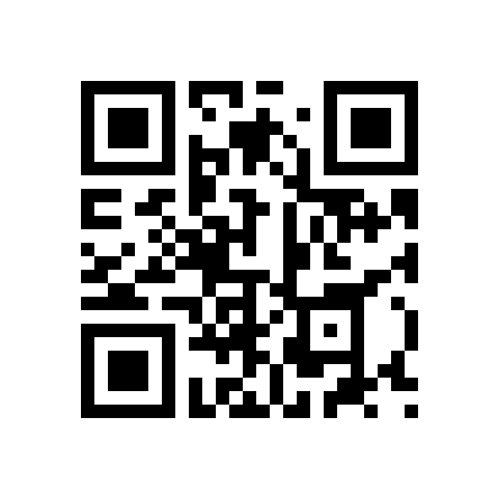
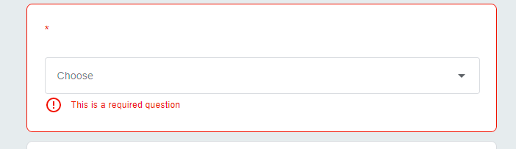

Feedback
tinyurl.com/evaluationSEND
Emotion Coaching: Parent/Carer Workshop - 09.12.22 - D Dowd

