Slide 1

Starting school in 2025
Update for 2018
1
Notes:
1

Slide 2
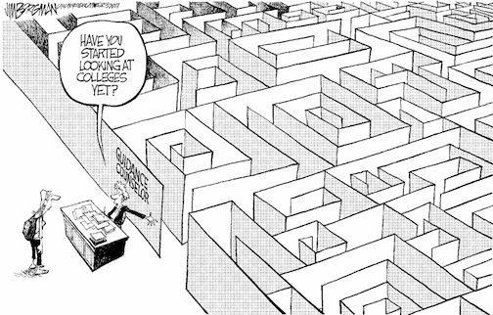
Choosing a school
Have you
started
looking
at schools
yet?

Slide 3
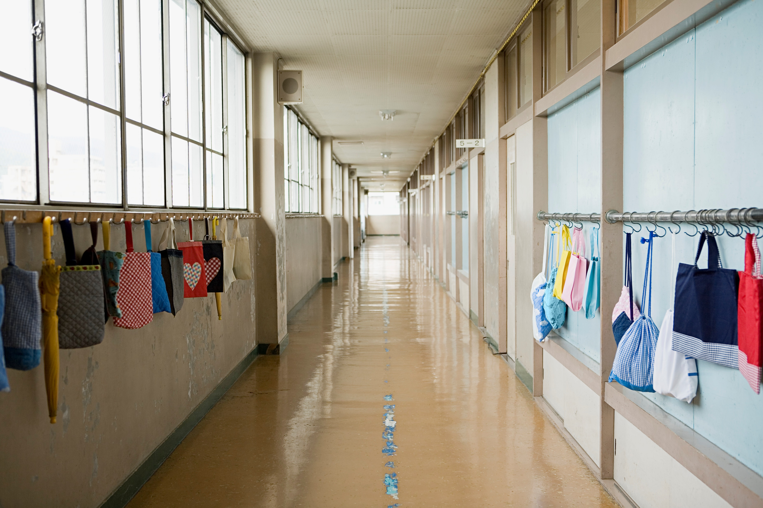
Choosing a school
How do I know which school is right for my child?
Who can help me make that decision?

Slide 4

Choosing a school
Talk to your child
  find out what is best for them
  consider how they will travel to school

Slide 5

Choosing a school
Choosing a school
Visit the schools
  talk to the headteacher & staff
  ask for a tour of the school
  … however, you will need to check the visiting arrangements with individual schools as access may be restricted post-Covid

Slide 6

Choosing a school
Read the school prospectus
  it will have detailed information about:
    how the school is run
    the admissions criteria
  available from the school
  download from the school website

Slide 7

Choosing a school
Read the primary education booklet published by your home local authority
  download Barnet’s booklet at www.barnet.gov.uk/schooladmissions

Slide 8
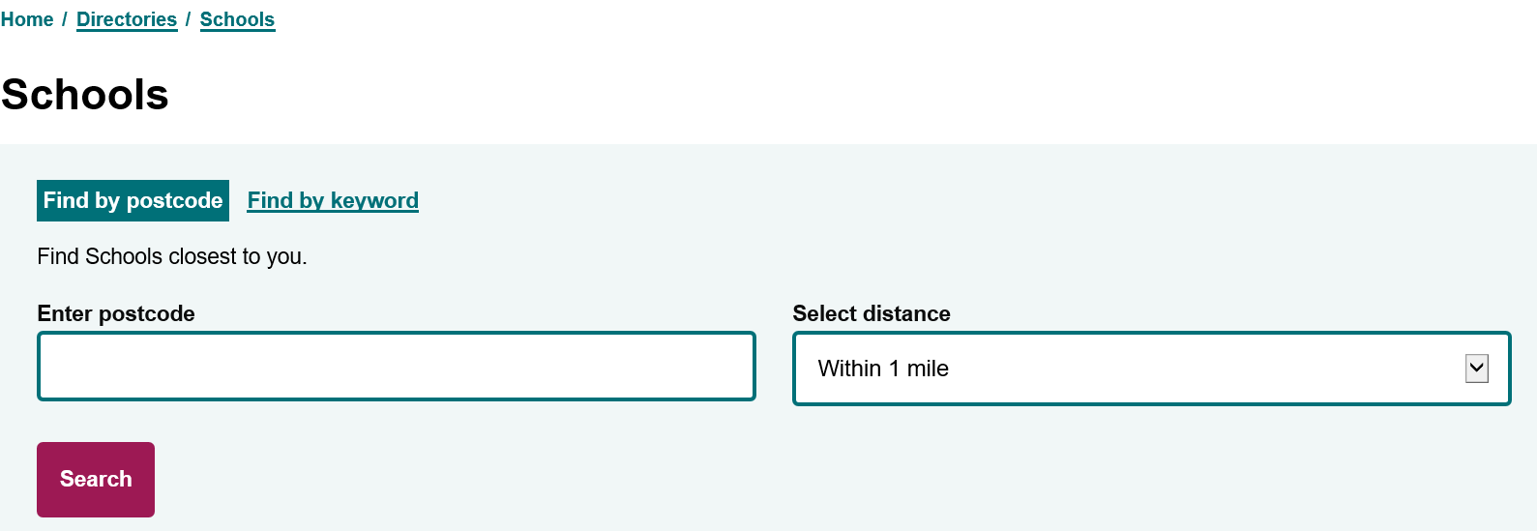
Choosing a school
You can also find details of Barnet primary schools in the Schools Directory at
www.barnet.gov.uk/directories/schools

Slide 9

Choosing a school
Talk to the Customer Contact Centre
  the team can offer you advice and answer your questions
  how do I contact them?
    tel: 020 8359 7651
    if you live outside Barnet, you will find the contact details for your admissions team in Barnet’s primary education booklet

Slide 10


Choosing a school
Look at Performance Tables and Ofsted reports
  the latest Ofsted reports are available from the Ofsted website www.ofsted.gov.uk
  achievement and attainment tables are available at www.gov.uk/school-performance-tables

Slide 11

Choosing a school
Look carefully at the admission criteria for each school
  siblings
  children of staff
  distance

Slide 12
Barnet Community Schools Allocations April 2024
Name of School | Places Available | Total number of on-time applications | Siblings | Furthest distance offered (miles)
 |  |  |  | Children living in defined area | Children living outside defined area
Barnfield Primary | 60 | 222 | 23 | All | 0.384
Bell Lane Primary | 60 | 90 | 13 | All | All
Brookland Infant | 90 | 241 | 31 | All | 1.271
Brunswick Park Primary | 60 | 193 | 18 | All | All
Chalgrove Primary | 30 | 143 | 9 | All | 0.736
Church Hill Primary | 30 | 120 | 8 | All | All
Colindale Primary | 90 | 271 | 31 | 0.526 | None
Coppetts Wood Primary | 30 | 92 | 14 | All | All
Courtland Primary | 30 | 129 | 8 | All | 0.819
Cromer Road Primary | 60 | 215 | 30 | 0.337 | None
Danegrove Primary | 90 | 200 | 31 | All | 0.889
Deansbrook Infant | 90 | 91 | 18 | All | All
Dollis Primary | 60 | 79 | 11 | All | All
Edgware Primary | 90 | 139 | 23 | All | All
Fairway Primary | 30 | 65 | 11 | All | All
Foulds Primary | 45 | 171 | 13 | All | 0.704
Frith Manor Primary | 60 | 219 | 16 | All | 1.208
Garden Suburb Infant | 90 | 150 | 19 | All | All
Goldbeaters Primary | 60 | 311 | 26 | 0.331 | None
Holly Park Primary | 60 | 98 | 20 | All | All
Livingstone Primary | 30 | 168 | 7 | 0.463 | None
Manorside Primary | 30 | 194 | 11 | 0.388 | None
Martin Primary | 90 | 225 | 35 | All | All
Monkfrith Primary | 60 | 228 | 21 | All | 0.824
Moss Hall Infant | 120 | 277 | 35 | All | All
Northside Primary | 30 | 176 | 8 | 0.271 | None
Queenswell Infant | 60 | 117 | 11 | All | All
Sunnyfields Primary | 30 | 165 | 10 | 0.330 | None
The Orion Primary | 120 | 437 | 59 | All | 0.223
Tudor Primary | 30 | 68 | 8 | All | All
Underhill Primary | 60 | 114 | 16 | All | All
Wessex Gardens Primary | 60 | 50 | 8 | All | All
Whitings Hill Primary | 60 | 182 | 34 | 0.545 | None
Woodcroft Primary | 60 | 92 | 10 | All | All
Woodridge Primary | 30 | 168 | 16 | All | 0.412

Slide 13
Allocations at Voluntary Aided , Foundation, Free Schools & Academies
N/A=Demand met
Name of School | Places Available | Total number of applicants | Criterion under which final place offered (furthest straight-line distance in miles shown where applicable)
Akiva Jewish | 60 | 151 | Meets top faith priority (1.635)
All Saints' CE (N20) | 30 | 107 | N/A
All Saints' CE (NW2) | 30 | 46 | N/A
Alma Jewish | 30 | 97 | N/A
Ashmole Primary | 60 | 294 | Straight-line distance (0.514)
Annunciation Catholic Infant | 60 | 69 | N/A
Beis Yaakov Jewish | 58 | 63 | N/A
Beit Shvidler Jewish | 30 | 49 | N/A
Blessed Dominic Catholic | 60 | 162 | Any Other Children (0.053)
Broadfields | 90 | 101 | N/A
Childs Hill | 60 | 135 | N/A
Christ Church CE | 30 | 88 | N/A
Claremont | 60 | 81 | N/A
Etz Chaim Jewish | 30 | 94 | Proximity (0.557)
Hasmonean Jewish | 30 | 54 | N/A
Hollickwood | 30 | 47 | N/A
Holy Trinity CE | 30 | 79 | N/A
Independent Jewish Day | 28 | 66 | Certificate of religious practice (Lottery)
London Academy | 30 | 66 | N/A
Mathilda Marks Kennedy | 30 | 95 | N/A
Menorah Foundation Jewish | 30 | 65 | All Others Who Meet Religious Criteria (Lottery)
Menorah Primary Jewish (Boys) | 25 | 38 | Orthodox Jewish Who Are 'First Children' (Lottery)
Menorah Primary Jewish (Girls) | 25 | 39 | Orthodox Jewish Who Are 'First Children' (Lottery)
Millbrook Park | 60 | 151 | Straight-line distance (3.554)
Monken Hadley CE | 20 | 148 | Children Within 2 Miles & Worship At Holy Trinity Church (1.312)
Osidge | 60 | 160 | N/A
Our Lady of Lourdes RC | 30 | 82 | N/A
Pardes House Jewish | 52 | 65 | Any other Orthodox Jewish children (1.814)
Parkfield | 60 | 127 | N/A

Slide 14
Allocations at Voluntary Aided , Foundation, Free Schools & Academies (cont…)
Name of School | Places Available | Total number of applicants | Criterion under which final place offered (furthest straight-line distance in miles shown where applicable)
Rimon Jewish | 30 | 81 | GG Synagogue attendance level 1 (1.868)
 |  |  | Straight-line distance (0.408)
Rosh Pinal Jewish | 60 | 159 | N/A
Sacks Morasha Jewish | 30 | 81 | Priority Children Who Attend Orthodox Synagogue In Catchment (2.430)
Sacred Heart RC | 60 | 126 | N/A
Shalom Noam Primary | 30 | 67 | Other Orthodox Jewish (Lottery)
St Agnes' Catholic | 60 | 134 | Any Other Children (0.147)
St Andrew's CE | 30 | 128 | All Others Living In The Parish (0.577)
St Catherine's Catholic | 60 | 147 | Any other applicant (0.935)
St John's CE (N11) | 30 | 91 | Any other children (0.330)
St John's CE (N20) | 30 | 154 | Resident in the Parish of St John The Apostle (0.249)
St Joseph's Catholic | 60 | 132 | N/A
St Mary's and St John's CE | 90 | 156 | N/A
St Mary's CE (EN4) | 30 | 125 | Resident of the 4 Eligible Parishes (0.516)
St Mary's CE (N3) | 60 | 105 | N/A
St Paul's CE (N11) | 30 | 44 | N/A
St Paul's CE (NW7) | 30 | 81 | Any other applicants (1.138)
St Theresa's RC | 30 | 65 | N/A
St Vincent's RC | 45 | 79 | N/A
Summerside | 60 | 102 | N/A
The Hyde | 60 | 245 | Inside catchment area (0.710)
Trent CE | 30 | 111 | Member Of Christ Church (0.382)
Watling Park | 60 | 120 | N/A
Wren Academy | 60 | 243 | Faith Band: Other Christian denomination (0.780)
 |  |  | Community Band: Straight-line distance (0.311)

Slide 15
Choosing a school
Check the admission limit
  each school has a set number of places available
  this means some schools only have one form of entry (30 places)
  larger schools have 3 or 4 forms of entry

Slide 16


How do I apply?
How soon can I apply?
  The online application system opened on 1 September 2024
  Where do I apply?
  You need to apply online at www.eadmissions.org.uk
  (or check your Local Authority’s website if you live outside London)
What if I don’t have a computer at home?
  You can:
    use your smart phone or tablet
    go to your local library
    go to an internet café
    ask a friend or relative for help

Slide 17
How do I apply?
How many schools can I apply for?
  you can apply for up to six schools
  you should rank the schools in your order of preference
  it is important to think carefully about the order as you will not be able to change it after the closing date
Can I apply to schools outside Barnet?
  yes, you must include all your chosen schools on the single application form, whether they are inside or outside the borough where you live

Slide 18

How do I apply?
Realistic Preferences
  if you only select one school, it will not increase your chances of getting a place at the school and your child will be considered for that one school only
  if this is unsuccessful, you may miss out on an offer which could have been made at another school and you are likely to be offered a place at the nearest school with a vacancy
  it is important to make realistic school choices to increase your chances of securing an offer and to avoid disappointment
  it is important to check how places were offered last year
  remember the cut-off distances are just a guide and will change every year……
  ……just because you live nearer to the school than the last child offered a distance place last year, it doesn’t mean your child is guaranteed a place

Slide 19

How do I apply?
Do I need to fill in any other forms?
  All voluntary aided schools and some foundation schools & academies will ask you to complete a Supplementary Information Form (SIF)
  the SIF will ask for additional information, for example
    faith schools will ask about church attendance and request a priest’s reference
    Catholic schools may ask for a Certificate of Catholic Practice (CCP)
    Jewish schools will also ask you to complete a Certificate of Religious Practice (CRP), which must be signed by a Rabbi
  SIFs, CCPs and CRPs must be returned to the individual schools

Slide 20
How do I apply?
How do I apply?
What else do I need to provide?
  Proof of address
    your permanent address must be used on the application form
    you must not use a temporary address or an address of convenience, this includes a childminder’s address, a business address or the address of a relative or friend
    if you own a property previously used as a home address and apply from another address, the second address will be treated as an address of convenience
    if you have moved in recent months, you may be asked to provide proof of the new address and proof that you have disposed of the previous address
  A copy of your child’s short birth certificate

Slide 21
Fraudulent address
  each year a small number of parents provide a false address to get a school place
  in doing so they could be depriving your child of a place
  providing false information is a criminal offence
  if you know someone who intends to use a false address, you can report this in confidence to the Corporate Anti-Fraud Team
  report it online at www.barnet.gov.uk/anti-fraud
  call the fraud hotline on 020 8359 2007

Slide 22

How do I apply?
When is the closing date for on-time applications?
  15 January 2025
  You must apply before 12 midnight on 15 January

Slide 23

How do I apply?
What happens if I miss the closing date?
    Your application will be given lower priority than on-time applications
    in previous years, some children did not get a place at their older sibling’s school because their applications were late
    some late applications may be treated as ‘on-time’ if there is an exceptional reason (for example you have just moved into the borough)
    You must let the Admissions Team know your reason by 12 February 2025 (Reason for Late Application Form, will be available online).

Slide 24
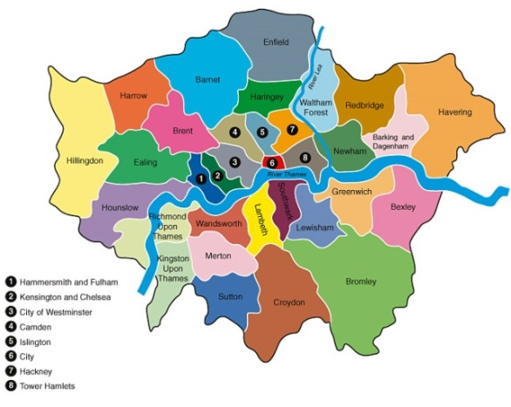
What happens next?
What happens next?
Co-ordinated admissions
  the admissions process is co-ordinated by all 33 London boroughs, neighbouring boroughs and other home counties
  application lists are exchanged
  offer lists are drawn up
  offer lists are exchanged.

Slide 25
What happens next?
What happens next?
How will places be allocated?
  if the school is oversubscribed, the published oversubscription criteria will be applied to decide who can be offered a place
  each school listed on the application form will be considered against the individual school’s oversubscription criteria
  your order of school preference is not passed to the individual schools.

Slide 26
Offers
Will I be offered more than one school place?
  Where the applicant qualifies for a place at more than one school, a place will be offered at the school that was ranked higher on the application form
  any lower preferences will be withdrawn and offered to other children
  no child will be offered more than one school.

Slide 27
Offers
When will I hear?
  National Offer Day is Wednesday 16 April 2025
  outcome emails will be sent to all applicants in the evening of 16 April
  applicants who are not offered their first choice will be given further information about waiting lists and appeals in their offer letters

Slide 28

Offers
Accepting offers
  click on the ‘Reply’ button at the bottom of the offer email notification and log into your eAdmissions account and submit your response
  places must be accepted by 30 April 2025

Slide 29

No offer
What happens if I don’t get any of my preference schools?
  where possible your child will be allocated an alternative school
  this will normally be the nearest school with a vacancy
  remain on the waiting lists
  appeal for a place

Slide 30

Appeals
Appeals
every parent has the right of appeal
appeals are heard by an independent panel
you will have the opportunity to present your case in person

Slide 31
….however
……however
Reception class appeals are nearly always unsuccessful because….
infant class sizes must not exceed 30 children
infant class appeals are only successful if you can prove that the local authority or the school has made a mistake
or that
the decision not to offer a place was not rational or was outrageous in its defiance of logic

Slide 32
Starting school in 2025
Update for 2018
32
Notes:
32

